Slide 1

Technical Paper Presentation
Track Number: 1B
Paper ID: 412
Paper Title: “A Feature-Based Recommendation System for Mobile Number Portability”.
Authors: Yugma Patel, Vrukshal Patel, Mohammad S. Obaidat, Nilesh Kumar Jadav, Rajesh Gupta, Sudeep Tanwar.

Slide 2
Presentation Outline
Introduction
Proposed scheme
Performance evaluation
Conclusion
References

Slide 3
Introduction
Internet has opened doors for endless opportunities for every individual across the globe.
during the time of covid-19 pandemic businesses shifted to work-from-home, education shifted to e-learning requiring individuals to have reliable and affordable internet connection[4].
Mobile number portability is a service using which mobile number users can change their telecom company without changing their phone number.
[4] “need of strong internet during covid-19 pandemic.” https://blogs.worldbank.org/voices/covid-19-reinforces-needconnectivity, 2020. Accessed: 2021-11-25.

Slide 4
Introduction (Related to contributions)
The security and privacy issues can be easily solved by integration of federated learning in 6G-V2X ecosystems.
A federated Learning (FL) approach is suitable, that supports edge nodes through effective global aggregation and balanced resource offloading, that improves the quality-of-experience of user.
Predicted data is stored as interplanetary file systems (IPFS) transactions to ensure trust and privacy among multiple nodes.
The locally trained gradients are aggregated, and then the main global server computes the globalized gradient.
The globalized gradient is used to train the global model, The result of which is stored in BC.
The updated model than communicate with the vehicle node to improve the precision and accuracy of V2X predictive services.

Slide 5
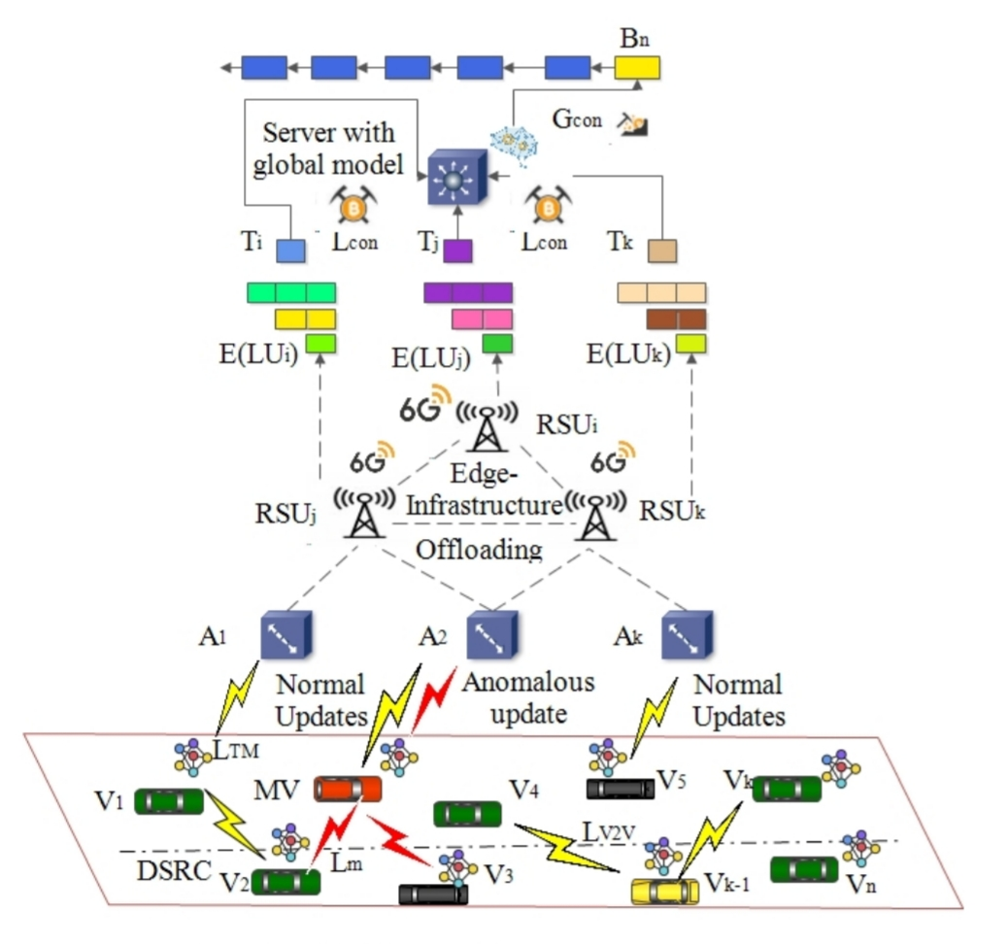
Proposed scheme
Fig. 1 Proposed scheme for V2X communication by adopting federated learning and 6G network

Slide 6
Proposed scheme (Continue)
Federated Edge Learning Model
In FL edge model, we consider that a global server Gs communicate the global model GM to all the local V_{n} nodes for training.
Every V_{n} node downloads GM, and train the model through local data D_{n}.
The local training models for all n vehicles is represented as {LTM₁ , LTM₂ , . . . , LTM_{n} }.
The local model updates are communicated to verifier nodes Vp(V₁, V₂, . . . , V_{p}}.
PoLL: The Blockchain consensus model
In the BC-model, we present a trusted framework for sharing the LML updates, through a proposed consensus scheme, termed as PoLL.
In PoLL, we assume that transaction set T include local updates, which is validated via m miner nodes.
Every miner node {N₁, N₂, . . . , N_{m}} maintains a local ledger with local LMLs.
The newly generated block is added to the chain.

Slide 7
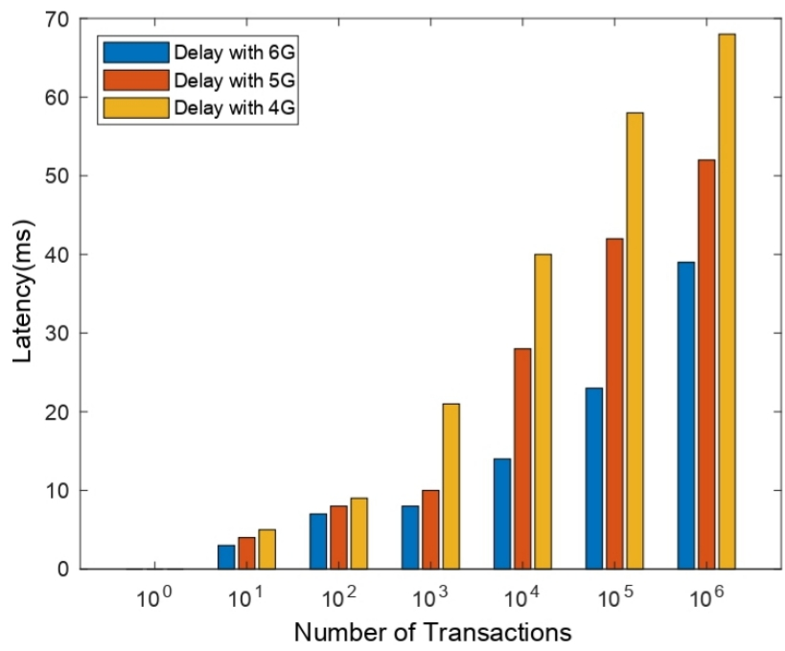
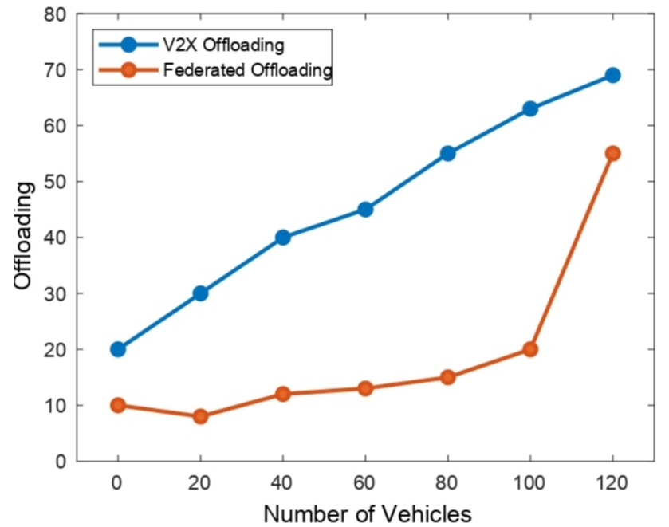
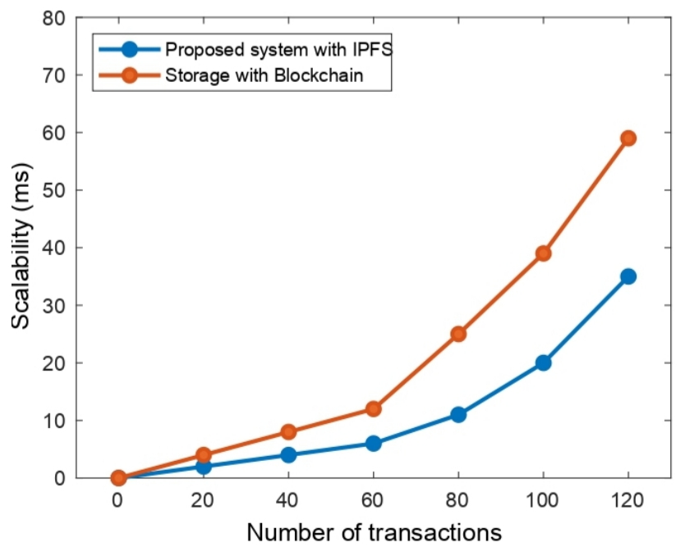
Performance evaluation of BFLEdge
Latency
Federated offloading
Scalability
It is evident that the 6G systems have better properties compared to a 4G or 5G system, such as ultrahigh reliability, ultra-low latency, and ubiquitous high data rate.
As the number of vehicles increases, the V2X offloading increases linearly. However, in federated learning, each client id independently trains, resulting in reduced offloading to a threshold.
It is apparent from the graph that, as the number of data transactions increases between V2X, the proposed system scalability gets improved compared to the conventional systems.

Slide 8
Conclusion
The paper proposes a BC and FL-based scheme, BFLEdge to improve the learning rate of FL model. We have used the communication network as 6G, which improves the system latency and reliability.
BFLEdge addresses the key issue of data offloading, while processing the information, which in turn improves the accuracy of the main model.
In order to mitigate the trust issues, we designed a consensus protocol, i.e., PoLL for sharing LML updates with the main model.
The performance of BFLEdge scheme is evaluated by considering data offloading, scalability, and communication latency over the traditional non-blockchain and 5G-based systems.

Slide 9
References
[1] M. Giordani, M. Polese, M. Mezzavilla, S. Rangan, and M. Zorzi, “Toward 6g networks: Use cases and technologies,” IEEE Communications Magazine, vol. 58, no. 3, pp. 55–61, 2020.
[2] C. Xu, H. Liu, P. Li, and P. Wang, “A remote attestation security model based on privacy-preserving blockchain for v2x,” IEEE Access, vol. 6, pp. 67809–67818, 2018.
[3] D. B. Rawat, R. Doku, A. Adebayo, C. Bajracharya, and C. Kamhoua, “Blockchain enabled named data networking for secure vehicle-toeverything communications,” IEEE Network, vol. 34, no. 5, pp. 185–189, 2020.
[4] J. Gao, M. R. Khandaker, F. Tariq, K.-K. Wong, and R. T. Khan, “Deep neural network based resource allocation for v2x communications,” in 2019 IEEE 90th Vehicular Technology Conference (VTC2019-Fall), pp. 1–5, IEEE, 2019.
[5] M. Shayan, C. Fung, C. J. Yoon, and I. Beschastnikh, “Biscotti: A blockchain system for private and secure federated learning,” IEEE Transactions on Parallel and Distributed Systems, vol. 32, no. 7, pp. 1513–1525, 2020.
[6] S. R. Pokhrel and J. Choi, “Federated learning with blockchain for autonomous vehicles: Analysis and design challenges,” IEEE Transactions on Communications, vol. 68, no. 8, pp. 4734–4746, 2020.
[7] Y. Lu, X. Huang, K. Zhang, S. Maharjan, and Y. Zhang, “Blockchain empowered asynchronous federated learning for secure data sharing in internet of vehicles,” IEEE Transactions on Vehicular Technology, vol. 69, no. 4, pp. 4298–4311, 2020.
[8] Q. Zhang, P. Palacharla, M. Sekiya, J. Suga, and T. Katagiri, “Blockchain-based secure aggregation for federated learning with a traffic prediction use case,” in 2021 IEEE 7th International Conference on Network Softwarization (NetSoft), pp. 372–374, IEEE, 2021.
[9] Y. Peng, Z. Chen, Z. Chen, W. Ou, W. Han, and J. Ma, “Bflp: An adaptive federated learning framework for internet of vehicles,” Mobile Information Systems, vol. 2021, 2021.
[10] M. Mizmizi, D. Tagliaferri, D. Badini, C. Mazzucco, and U. Spagnolini, “Channel estimation for 6g v2x hybrid systems using multi-vehicular learning,” arXiv preprint arXiv:2105.09689, 2021.

